Slide 1
Legal Notices
Terms and Conditions of Use
Thank you for downloading and using this WorldStrides “destination presentation.” By using this presentation, you signify your agreement to all terms, conditions, and notices contained or referenced herein ("Terms and Conditions of Use"). If you do not agree to these Terms and Conditions of Use, please do not use this presentation. WorldStrides reserves the right, in its sole discretion, to modify, alter or otherwise update these Terms and Conditions of Use at any time. By using this presentation after notice of such changes are posted, you agree to be bound by the modifications, alterations, or updates.
Copyright and Trademarks
This WorldStrides “destination presentation” contains copyrighted material, trademarks, and other proprietary information including, text, photos, and graphics. All content included in this presentation, such as text, photos, and logos, is protected by copyrights, trademarks, and other rights, which are owned and/or controlled by WorldStrides or by other parties. You may use material from this presentation only for educational purposes related to your WorldStrides travel program. This presentation or any portion of this presentation may not be modified, published, reproduced, duplicated, copied, uploaded, downloaded, posted, transmitted, sold, or otherwise exploited for any commercial purpose that is not expressly permitted by WorldStrides or expressly permitted under copyright law. In the event of any permitted copying, redistribution, or publication of copyrighted material, no changes in or deletion of author attribution, trademark legend or copyright notice shall be made. You acknowledge that you do not acquire any ownership rights by downloading copyrighted material. WorldStrides is not responsible for changes made to this presentation after it is downloaded.
Our Contact Information
WorldStrides
218 West Water Street, Suite 400
Charlottesville, VA 22902
(434) 982-8600
E-Mail: update@worldstrides.org
All content © 2014, WorldStrides

Slide 2
West Coast California
Notes:
WASHINGTON, D.C ENHANCES YOUR CURRICULUM
The WorldStrides DiscoverNow! Washington, D.C., program is an exciting journey that engages students in the history of our nation and the foundation of our government. Students become active participants in this learning adventure.
The most important component of this field study experience is student involvement. Whether honoring our heroes at Arlington National Cemetery, investigating the three branches of government at the Capitol, the White House, and the Supreme Court, or identifying the effects of decisions made by our nation’s leaders at the many memorials in Washington, D.C., the focus is on student participation, reflection, and internalization.

Slide 3
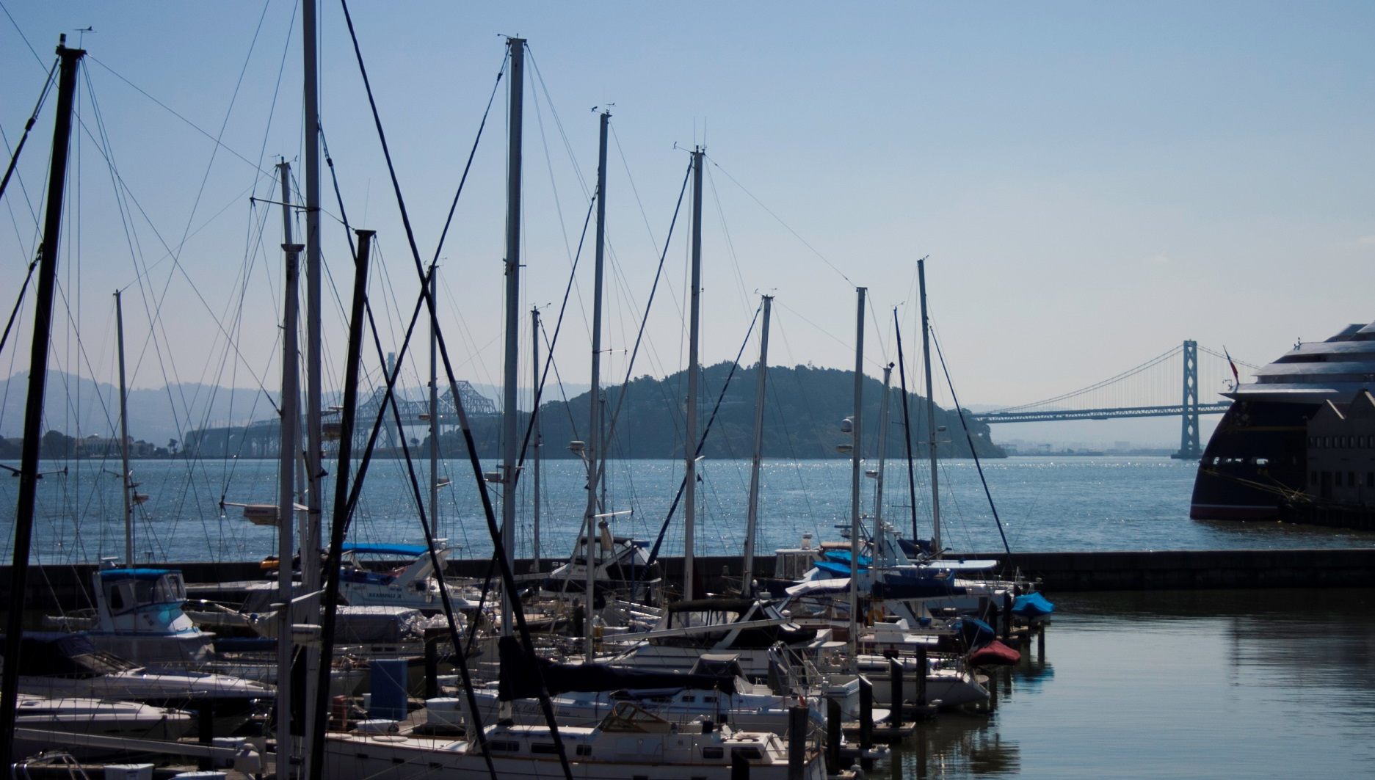
San Francisco
Set on a peninsula at the entrance to one of the world’s best natural harbors, San Francisco has been a center of maritime trade since the 1800’s
Notes:
Study the history and culture of San Francisco by visiting notable landmarks including the Golden Gate Bridge, Fisherman’s Wharf and the Marina District.
The California gold rush starting in 1848 led to a large boom in population, including considerable immigration. The rapid growth continued through the 1850s and under the influence of the 1859 Comstock Lode silver discovery. This rapid growth complicated city planning efforts, leaving a legacy of narrow streets that continues to cause traffic problems today. There was massive expansion in all directions, creating new neighborhoods such as the Haight-Ashbury, Eureka Valley, and the Mission District, and culminating in the construction of Golden Gate Park in 1887. The City's famous Cable Cars were built around this time to traverse the City's steep hills while connecting the new residential developments. San Francisco grew in cultural prominence at this time as famous writers Mark Twain, Bret Harte, Ambrose Bierce, Rudyard Kipling, Robert Louis Stevenson, and Oscar Wilde spent time in the city. San Francisco became America's largest city west of the Mississippi River, until it lost that title to Los Angeles in 1920.
The population boom included many workers from China who came to work in the gold mines and later on the Transcontinental Railroad. The Chinatown district of the city became and is still one of the largest in the country; today as a result of that legacy, the city as a whole is roughly one-fifth Chinese, one of the largest concentrations outside of China. Many businesses founded to service the growing population exist today, notably Levi Strauss & Co. clothing, Ghirardelli chocolate, and Wells Fargo bank. Many famous railroad, banking, and mining tycoons or "robber barons" such as Charles Crocker, Mark Hopkins, Collis P. Huntington, and Leland Stanford settled in the city in its Nob Hill neighborhood. The sites of their mansions are now famous and expensive San Francisco hotels (such as the Mark Hopkins Hotel and the Huntington Hotel).

Slide 4
Golden Gate Bridge
Notes:
The Golden Gate Bridge is a suspension bridge spanning the Golden Gate strait, the mile-wide, three-mile-long channel between San Francisco Bay and the Pacific Ocean. The structure links the U.S. city of San Francisco, on the northern tip of the San Francisco Peninsula, to Marin County. The bridge is one of the most internationally recognized symbols of San Francisco, California, and the United States. It has been declared one of the Wonders of the Modern World by the American Society of Civil Engineers. It opened in 1937 and had until 1964 the longest suspension bridge main span in the world, at 4,200 feet.

Slide 5
Alcatraz
Notes:
Alcatraz Island is located in the San Francisco Bay, offshore from San Francisco. Often referred to as "The Rock", the small island was developed with facilities for a lighthouse, a military fortification, a military prison (1868), and a federal prison from 1933 until 1963. Beginning in November 1969, the island was occupied for more than 19 months by a group of Aboriginal peoples from San Francisco who were part of a wave of Native activism across the nation with public protests through the 1970s. In 1972, Alcatraz became a national recreation area and received designation as a National Historic Landmark in 1986.

Slide 6
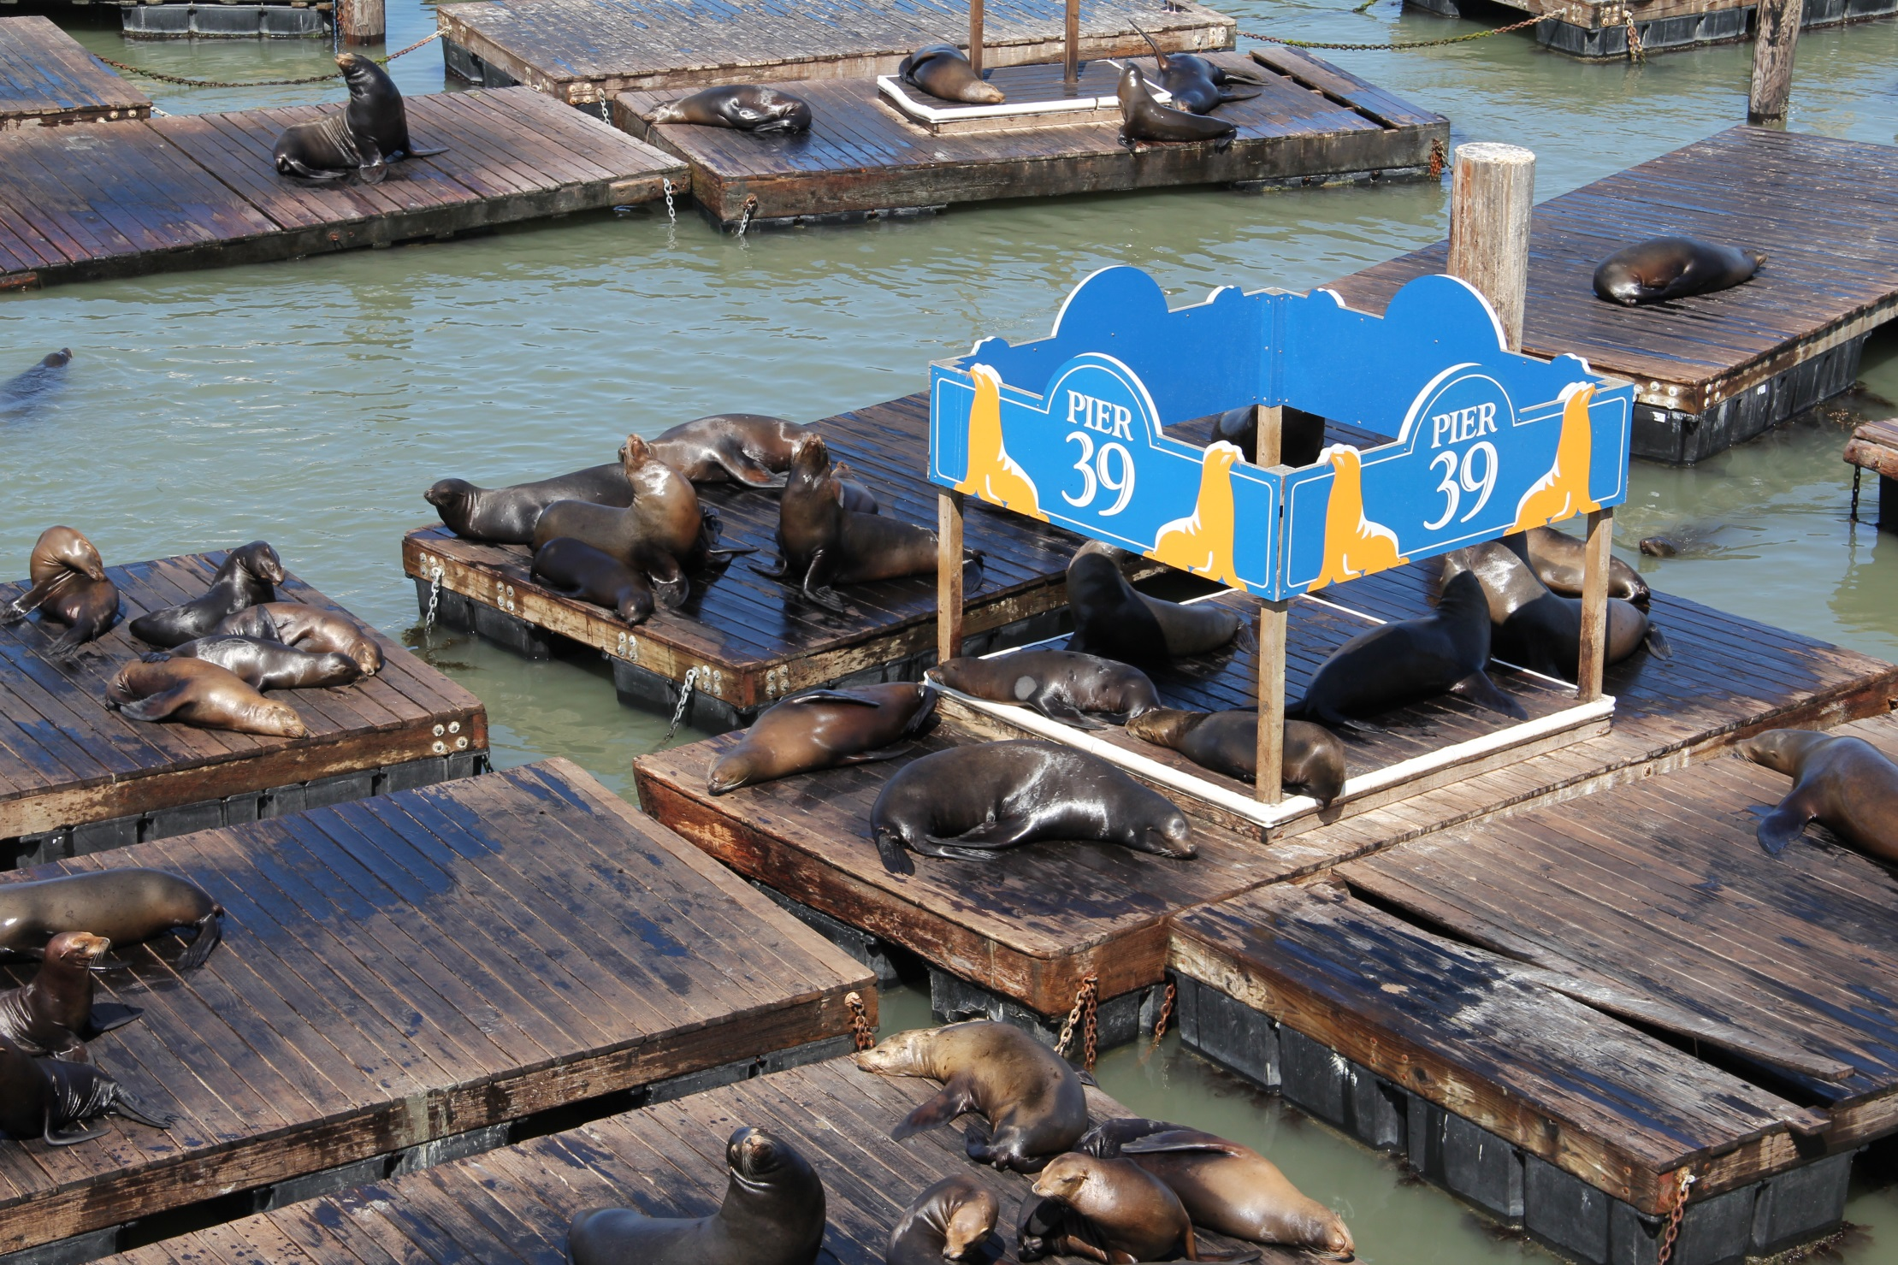
Pier 39 and Fisherman’s Wharf
Notes:
Pier 39 is a shopping center and popular tourist attraction built on a pier in San Francisco, California. There are shops, restaurants, a video arcade, street performances, an interpretive center for the Marine Mammal Center, the Aquarium of the Bay, virtual 3D rides, and views of California sea lions on docks of the marina.
The pier is located at the edge of the Fisherman's Wharf district. From the pier you can see Alcatraz, the Golden Gate Bridge, and the Bay Bridge.
Fisherman's Wharf gets its name and neighborhood characteristics from the city's early days of the mid to later 1800s when Italian immigrant fishermen came to the city by the bay to take advantage of the influx of population due to the gold rush. Here, you’ll enjoy watching street performers, visiting local shops, and the nostalgic feel of this popular neighborhood.

Slide 7
Cable Cars
Notes:
Soak in the sights of the city on one of San Francisco’s historic cable cars.
The San Francisco cable car system is the world's last manually operated cable car system. An icon of San Francisco, the cable car system forms part of the intermodal urban transport network operated by the San Francisco Municipal Railway. Of the twenty-three lines established between 1873 and 1890, three remain: two routes from downtown near Union Square to Fisherman's Wharf, and a third route along California Street.

Slide 8
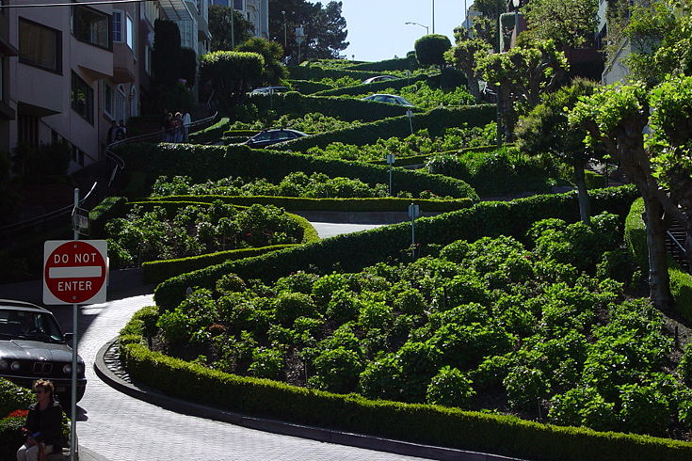
Lombard Street
Notes:
Walk along the zig-zaggy Lombard street, buzz around the neighborhood of Nob Hill, or enjoy people-watching at Union Square.
Lombard Street's western end is inside The Presidio; then it travels through the Russian Hill and Telegraph Hill neighborhoods, past Coit Tower and ending at The Embarcadero. Lombard Street is known for the one-way block on Russian Hill where eight sharp turns are said to make it the crookedest street in the world. The design was intended to reduce the hill's natural 27% grade.

Slide 9
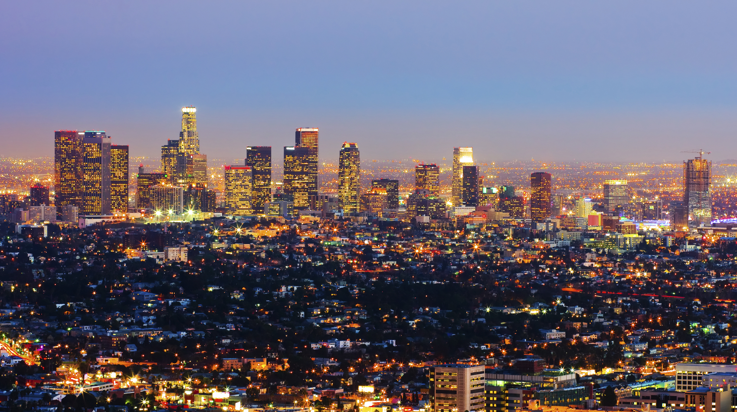
Los Angeles
As the largest city in California and the second largest city in the U.S., L.A. is visited by millions of people every year.
Notes:
Los Angeles was founded on September 4, 1781, by Spanish governor Felipe de Neve.
Nicknamed the City of Angels, Los Angeles is a global city, with strengths in business, international trade, entertainment, culture, media, fashion, science, sports, technology, education, medicine and research.

Slide 10
La Brea Tar Pits
Notes:
The La Brea Tar Pits are a group of tar pits around in urban Los Angeles. Natural asphalt (also called asphaltum, bitumen, pitch or tar - brea in Spanish) has seeped up from the ground in this area for tens of thousands of years. Over many centuries, the bones of animals that were trapped in the tar were preserved. The George C. Page Museum is dedicated to researching the tar pits and displaying specimens from the animals that died there. The La Brea Tar Pits are a registered National Natural Landmark.

Slide 11
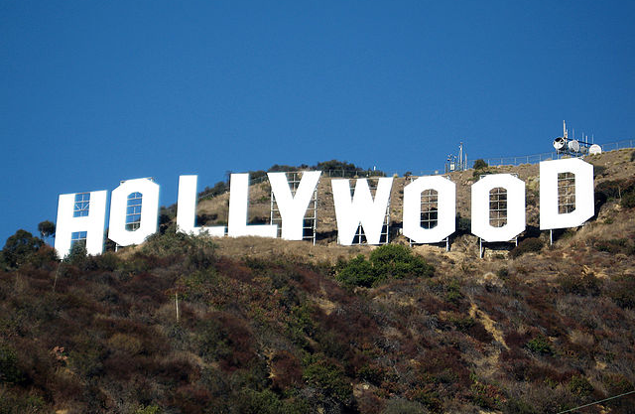
Hollywood
Notes:
Visit some of the most famous parts of this iconic city: Mulholland Drive and the Hollywood Sign (pictured here), Beverly Hills, Hollywood Boulevard, Grauman’s Chinese Theatre, Sunset Boulevard, Melrose Avenue, and of course the shopping on Rodeo Drive.

Slide 12
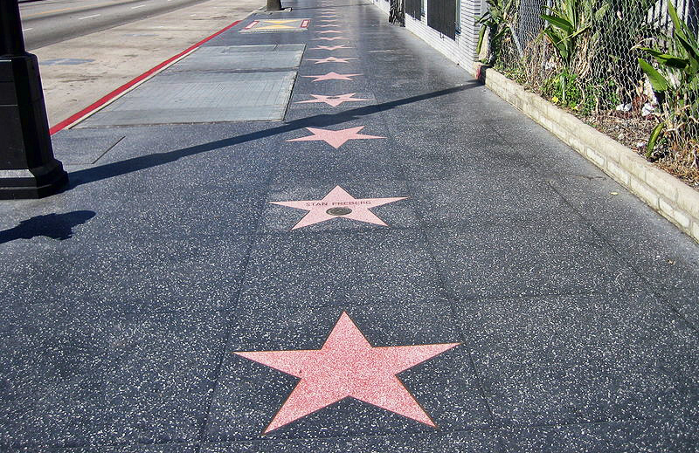
Walk of Fame
Notes:
Feel the excitement of Hollywood, walking the same streets as actors, musicians, and entertainers!
The Hollywood Walk of Fame comprises more than 2,500 five-pointed terrazzo and brass stars embedded in the sidewalks along 15 blocks of Hollywood Boulevard and three blocks of Vine Street in Hollywood, California. The stars are permanent public monuments to achievement in the entertainment industry, bearing the names of a mix of actors, musicians, directors, producers, musical and theatrical groups, fictional characters, and others.

Slide 13
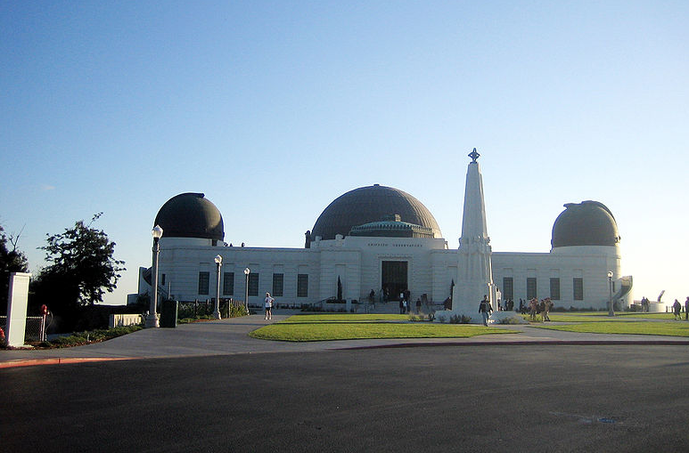
Griffith Observatory
Notes:
Learn about the history of astronomy and how to identify stars and constellations at the Griffith Observatory.
The observatory sits on the south-facing slope of Mount Hollywood in Los Angeles' Griffith Park. It commands a view of the Los Angeles Basin, including Downtown L.A. to the southeast, Hollywood to the south, and the Pacific Ocean to the southwest. The observatory is a popular attraction with an extensive array of space and science-related displays.
The land surrounding the observatory was donated to the City of Los Angeles by Colonel Griffith J. Griffith in 1896. In his will Griffith donated funds to build an observatory, exhibit hall, and planetarium. Griffith's objective was to make astronomy accessible by the public, as opposed to the prevailing idea that observatories should be located on remote mountaintops and restricted to scientists.
As a Works Progress Administration (WPA) project, construction began in 1933.The observatory and accompanying exhibits were opened to the public in 1935.
Some exhibits of note: the Foucault pendulum, which was designed to demonstrate the rotation of the Earth and the Tesla Coil, generating very large sparks.

Slide 14
Santa Monica Pier
President Memorials and Monuments
Notes:
A favorite destination for locals and visitors alike for over 100 years. The Ferris wheel, the shops, the arcade…southern California sure knows how to impress.
The long, narrow Municipal Pier opened in 1909,primarily to carry sewer pipes beyond the breakers, and had no amenities. The short, wide adjoining Newcomb Pier (aka the “Pleasure Pier”), was built in 1916.
To this day, Playland Arcade is the Pier’s longest running enterprise offering the day’s contemporary games alongside those of yesterday, providing inexpensive entertainment to a diverse crowd.

Slide 15
Universal Studios
Notes:
Enjoy action-packed entertainment all in one place: thrilling theme park rides, spectacular shows, and movie-themed fun!

Slide 16
VIP Back lot Tour
Notes:
And finally, no trip to L.A. would be complete without movie stars. Get a glimpse of the celebrity life on a back lot tour of a real Hollywood studio!

